Slide 1
Regression Analysis
Logistic Regression
Nicoleta Serban, Ph.D.
Professor
Stewart School of Industrial and Systems Engineering
The Demographics of Obesity: Goodness of Fit

Slide 2

About This Lesson

Slide 3
Logistic Regression With Replications
### Aggregate data for Logistic Regression with repetitions
obdata.agg.n = aggregate(Obesity~agegr+gender+edu, FUN=length)
obdata.agg.y = aggregate(Obesity~agegr+gender+edu, FUN=sum)
obdata.agg = data.frame(Obesity = obdata.agg.y$Obesity,
Total = obdata.agg.n$Obesity,
agegr = obdata.agg.n$agegr,
gender = obdata.agg.n$gender,
edu = obdata.agg.n$edu)
## Fit a logistic regression model
model.agg = glm(cbind(Obesity,Total-Obesity)~agegr+gender+edu,
data=obdata.agg, family=binomial)
## Test for GOF: Using deviance residuals
c(deviance(model.agg), 1-pchisq(deviance(model.agg),40))
[1] 29.0640209 0.8996714

Slide 4
Logistic Regression With Replications
### Aggregate data for Logistic Regression with repetitions
obdata.agg.n = aggregate(Obesity~agegr+gender+edu, FUN=length)
obdata.agg.y = aggregate(Obesity~agegr+gender+edu, FUN=sum)
obdata.agg = data.frame(Obesity = obdata.agg.y$Obesity,
Total = obdata.agg.n$Obesity,
agegr = obdata.agg.n$agegr,
gender = obdata.agg.n$gender,
edu = obdata.agg.n$edu)
## Fit a logistic regression model
model.agg = glm(cbind(Obesity,Total-Obesity)~agegr+gender+edu,
data=obdata.agg, family=binomial)
## Test for GOF: Using deviance residuals
c(deviance(model.agg), 1-pchisq(deviance(model.agg),40))
[1] 29.0640209 0.8996714
With replications, we can perform a goodness of fit test.
p-value = 0.899 indicates a good fit.

Slide 5
Logistic Regression With Replications
summary(model.agg)
Coefficients:
Null deviance: 127.701 on 49 degrees of freedom
Residual deviance: 29.064 on 40 degrees of freedom
 | Estimate | Std. Error | z value | Pr(>|z|)
(Intercept) | -1.20581 | 0.15730 | -7.666 | 1.78e-14 ***
agegr25to34 | 0.47271 | 0.14428 | 3.276 | 0.001052 **
agegr35to44 | 0.76486 | 0.14196 | 5.388 | 7.13e-08 ***
agegr45to64 | 0.84815 | 0.13240 | 6.406 | 1.49e-10 ***
agegr65+ | 0.60086 | 0.13751 | 4.370 | 1.24e-05 ***
genderFemale | 0.23041 | 0.06363 | 3.621 | 0.000293 ***
edu9to11Grade | 0.05632 | 0.12229 | 0.461 | 0.645110
eduHighSchool | -0.03440 | 0.11436 | -0.301 | 0.763579
eduSomeCollege | 0.13947 | 0.11036 | 1.264 | 0.206301
eduCollege+ | -0.40077 | 0.11757 | -3.409 | 0.000653 ***
Regression coefficient output for estimation and statistical inference is the same with or without replications.
Null and residual deviance output is different with replications. Why?

Slide 6
Residual Analysis
res = resid(model.agg, type="deviance")
par(mfrow=c(2,2))
boxplot(res~agegr,
xlab="Age Group",
ylab="Std residuals",
data=obdata.agg)
boxplot(res~gender,
xlab="Gender",
ylab="Std residuals",
data = obdata.agg)
qqnorm(res, ylab="Std residuals")
qqline(res, col="blue", lwd=2)
hist(res, 10, xlab="Std residuals", main="")
Notes:
We do note that the model still only fits moderately well, even after including the quadratic term in age. One possible reason for this is that the relationship with age, while being nonlinear (in terms of the logit), is not quadratic. We can investigate that possibility by entering age into
the model as a categorical (factor) variable, rather than as a numerical one; this allows for any relationship with age.

Slide 7
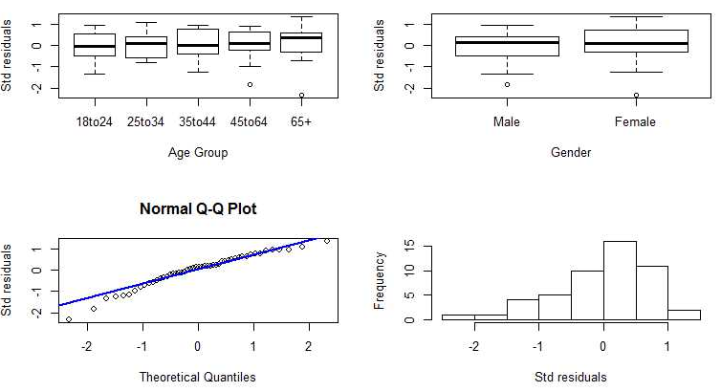
Residual Analysis
Notes:
We do note that the model still only fits moderately well, even after including the quadratic term in age. One possible reason for this is that the relationship with age, while being nonlinear (in terms of the logit), is not quadratic. We can investigate that possibility by entering age into
the model as a categorical (factor) variable, rather than as a numerical one; this allows for any relationship with age.

Slide 8
Prediction of Adult Obesity: Results
Both gender and age group factors are statistically significant factors in explaining the variability in the classification of adults by obesity.
But the fitted model with education, gender, and age group factors does not improve prediction.
After factor aggregation, goodness of fit can be performed.
The p-value of the deviance test for goodness of fit is high, indicating good fit.
  But residual analysis suggests that there may be some departures from normality and thus from goodness of fit.
Models with different link functions or including interaction terms have not shown improvement. (Results not shown in this lecture.)
The sample size is large enough for reliable statistical inference.
Notes:
Given all other predictors in the model, the duration of the movie and the total budget for production of the movie are not statistically significantly associated to the IMDb rating;
Given all other predictors in the model, each additional 10,000 votes results in an increase of 2.67 in IMDb score. That is, popular movies tend to be voted on more often;
Given all other predictors in the model, movies released in 2013 are rated 4.696 points higher than movies produced in 2010. Similarly, movies released in 2014 are rated 7.212 points higher than those released in 2010. Other years show no statistically significant difference from 2010. This seems to indicate a recency bias in how movies are rated on IMDb;
The predictors in the model explain close to 76% of the variability in IMDb scores.

Slide 9
Prediction of Adult Obesity: Results
Both gender and age group factors are statistically significant factors in explaining the variability in the classification of adults by obesity.
But the fitted model with education, gender, and age group factors does not improve prediction.
After factor aggregation, goodness of fit can be performed.
The p-value of the deviance test for goodness of fit is high, indicating good fit.
  But residual analysis suggests that there may be some departures from normality and thus from goodness of fit.
Models with different link functions or including interaction terms have not shown improvement. (Results not shown in this lecture.)
The sample size is large enough for reliable statistical inference.
What can be done to improve the model fit and the predictive power?
Include other factors in the model, such as income level, unemployment, race, and ethnicity, among others.
Consider interaction terms between age, education, and gender groups and other factors.
Notes:
Given all other predictors in the model, the duration of the movie and the total budget for production of the movie are not statistically significantly associated to the IMDb rating;
Given all other predictors in the model, each additional 10,000 votes results in an increase of 2.67 in IMDb score. That is, popular movies tend to be voted on more often;
Given all other predictors in the model, movies released in 2013 are rated 4.696 points higher than movies produced in 2010. Similarly, movies released in 2014 are rated 7.212 points higher than those released in 2010. Other years show no statistically significant difference from 2010. This seems to indicate a recency bias in how movies are rated on IMDb;
The predictors in the model explain close to 76% of the variability in IMDb scores.

Slide 10

Summary

